Slide 1
Objectives
In this session, you will learn to:
  Understand the basic terms related to excise
  Enable dealer excise in Tally.ERP 9
  Create masters and ledgers related to excise

Slide 2
Basic Concepts
Excise duty or Duty of Excise is a tax on goods produced or manufactured in India and intended for home consumption (sale in India).
Excise duty is chargeable at the time of production or manufacture, for convenience it is charged at the time of removal.
It is basically an indirect tax which the manufacturer or producer passes on to the ultimate consumer.
The levy and collection of Duty of Excise is provided under authority of the Central Excise Act, 1944 at the rates specified under the Central Excise Tariff Act, 1985.

Slide 3
Basic Concepts (Contd.)
Some of the basic terms related to Excise are:
  Excisable Goods
  Dealer of Excisable Goods
  First Stage Dealer
  Second Stage Dealer
  Registration of Dealers
  CENVAT Credit

Slide 4
Basic Concepts (Contd.)
Excisable Goods:
  Are goods specified in the schedule under the Central Excise Tariff Act, 1985 as being subject to a duty of excise.
  Must be:
    Movable
    Marketable
    Specified in the Central Excise Tariff Act

Slide 5
Basic Concepts (Contd.)
Dealer of Excisable Goods:
  Is a person who is registered under the Central Excise Rules.
  Can be of following categories:
    Depot of a manufacturer or the premises of the consignment agent of the manufacturer or any other premises from where the goods are sold on behalf of the manufacturer
    First stage dealer of excisable goods
    Second stage dealer of excisable goods
    Depot of an importer or the premises of the consignment agent of the importer
    First stage dealer of imported goods
    Second stage dealer of imported goods

Slide 6
Basic Concepts (Contd.)
First Stage Dealer:
  Is a person who purchases the goods directly from:
    The manufacturer registered under the provisions of Central Excise Rules, 2002, or representative of such manufacturer, under cover of an invoice.
    An importer or from the representative of such importer, under the cover of an invoice.
Second Stage Dealer:
  Is a person who purchases the goods from a first stage dealer.

Slide 7
Basic Concepts (Contd.)
Registration of Dealers:
  Every Dealer or Importer issuing Cenvatable Invoices should be registered with the jurisdictional Range Superintendent as per the procedure prescribed in Rule 9 of the Central Excise (No. 2) Rules 2001.
  The registration is valid only for the premises for which it is granted.
  If the manufacturer or dealer, has more than one premise, it is necessary to obtain a separate registration for each premise.
  The registration numbers are PAN based 15 digit alpha numeric.

Slide 8
Basic Concepts (Contd.)
CENVAT Credit:
  A manufacturer or producer of final products is allowed to take tax credit known as CENVAT credit on the following payments:
    Duty of excise specified in the First and Second Schedule to the Excise Tariff Act (ED).
    Additional duty of Excise leviable under Additional Duties of Excise (Textile and Textile Articles) (AED [T and TA]).
    Additional duty of Excise leviable under Additional Duties of Excise (Goods of Special Importance) (AED [GSI]).
    The National Calamity Contingent duty (NCCD) leviable under Finance Act.
    Education Cess on excisable goods.
    Additional Duty leviable under Customs Tariff Act.

Slide 9
Enabling Dealer Excise in Tally.ERP 9
The Dealer Excise module in Tally.ERP 9, facilitates complete Excise Accounting for dealers engaged in the trading of excisable goods and desiring to issue cenvatable invoices.
It minimises the possibility of erroneous data entry and ensures transparency and better levels of compliance with the statutes.
It takes a one-time configuration in Tally.ERP 9 for Dealer Excise features to be activated.

Slide 10
Enabling Dealer Excise in Tally.ERP 9 (Contd.)
The salient features of the excise module are:
  Simple and user-friendly
  Easy to setup and use
  Generates Excise Invoice raised by first and second stage registered dealers to pass on Cenvat Credit
  Allows Batch-wise Inventory details
  Provides an option to print details of Manufacturer or Supplier and all other relevant particulars of the corresponding purchase invoice
  Tracks the item history of excisable goods, right from the instance of purchase till the time of sale or passing or termination of Cenvat Credit

Slide 11
Enabling Dealer Excise in Tally.ERP 9 (Contd.)
  Generates statutory returns and excise related reports such as Form II and Stock Register
  Provides the flexibility to adjust unassigned Cenvat Credit well within the prescribed lapse period. Monnet Ispat & Energy Ltd
  Facilitates various Excise duty parameters like BED, AED (GSI), SED, NCCD, AED (T and TA), AED (T and TW) and Education Cess

Slide 12
Configuring Excise for Dealers in Tally.ERP 9
It takes a one-time configuration in Tally.ERP 9 for Excise features to be activated.
To enable Dealer Excise in Tally.ERP 9, you need to perform the following steps:
  Create Company
  Enable Excise
  Enable VAT

Slide 13

Demo: Configuring Excise for Dealers in Tally.ERP 9
Let us see how to configure Excise for Dealers in Tally.ERP 9.

Slide 14
Creating Masters
For recording Excise transactions for a dealer, the following masters are required to be created in Tally.ERP 9:
  Excise Voucher Type
  Ledgers
  Stock Items
Notes:
Share the session objectives with the students.

Slide 15
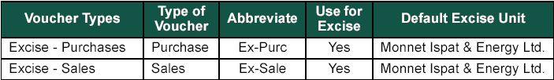
Demo: Creating Excise Voucher Types
Problem Statement:
  Create Excise Purchases and Excise Sales Voucher Types, to record Excise transactions with the required specifications, as shown in the following figure.
Notes:
Share the session objectives with the students.

Slide 16
Demo: Creating Excise Voucher Types (Contd.)
Let us see how to create Excise Voucher Types in Tally.ERP 9.

Slide 17
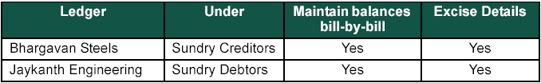
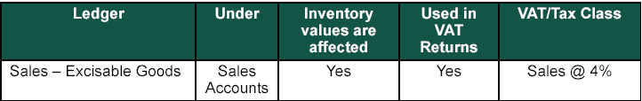
Demo: Creating Ledgers
Problem Statement:
  Create Party Ledgers, as shown in the following figure.
  Create Sales Ledger, as shown in the following figure.
Notes:
Share the session objectives with the students.

Slide 18

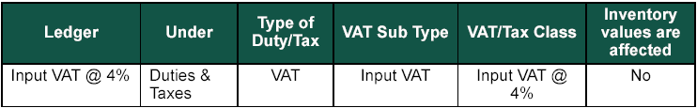
Demo: Creating Ledgers (Contd.)
  Create Purchase Ledger, as shown in the following figure.
  Create Sales Ledger, as shown in the following figure.
Notes:
Share the session objectives with the students.

Slide 19
Demo: Creating Ledgers (Contd.)
Let us create ledgers to solve the preceding problem statement in Tally.ERP 9.

Slide 20

Demo: Creating Stock Items
  Create stock item, as shown in the following figure.
Notes:
Share the session objectives with the students.

Slide 21
Demo: Creating Stock Items (Contd.)
Let us create stock items to solve the preceding problem statement in Tally.ERP 9.

Slide 22
Summary
In this session, you learned that:
  Excise duty is tax charged on goods manufactured and consumed within India.
  Goods to be Excisable must satisfy the three basic conditions i.e, it must be movable, marketable and specified in the Central Excise Tariff Act.
  CENVAT Credit is the set-off of duty paid on inputs used in the manufacture of final products, against the duty liability on such final products.
  Only the registered dealers are eligible to pass on or avail as the case may be the CENVAT Credit.
  Tally.ERP 9 permits you to create specific voucher types like Excise-Purchase and Excise-Sales for entering the excise related transactions.

